Slide 1
Fabrication and testing of III-V/Si tandem solar cells
PROMIS workshop, Cadiz, 18/05/2016
Stefano Soresi

Slide 2
Index
Introduction: the Goal
First steps: formations and monojunction solar cells
First results
The next steps

Slide 3
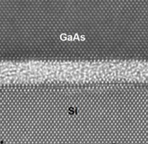
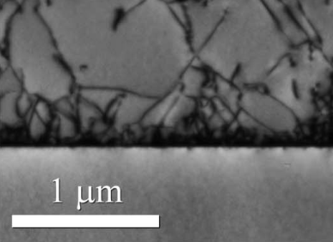
Introduction: the goal
Improvement of photovoltaic technologies:
How to combine best of III-V multijunction and
Si techniques ?
Different ways to do that: direct growth,
metamorphic growth, wafer bonding…
Issue: lattice and thermal mismatch,
polar/non-polar interfaces
Traditional Si solar cell
GaAs
Si
Traditional III-V multijunction solar cell
Direct growth
Wafer bonding

Slide 4
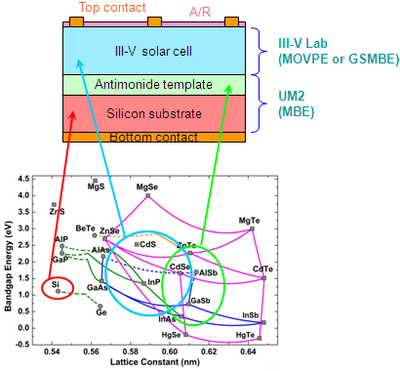
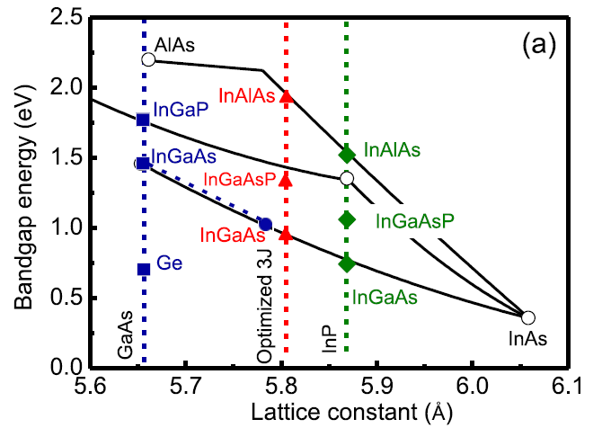
Introduction: the goal
Improvement of photovoltaic technologies:
How to combine best of III-V multijunction and
Si techniques ?
Different ways to do that: direct growth,
metamorphic growth, wafer bonding…
Issue: lattice and thermal mismatch,
polar/non-polar interfaces
Aim : combining III-V and Si by direct growth
through the use of Sb-based templates
Hypothetical final structure
Examples of ternary III-V solar cells

Slide 5
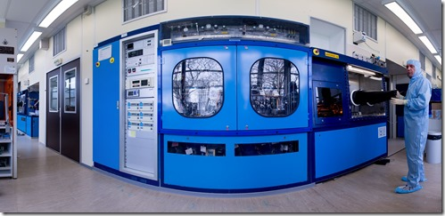
Formation
Formation in clean room processes
Epitaxy: MOVPE
Characterization techniques: XRD, C-V profiles,
Hall effect measurements, profilometry,
reflectometry, SIMS…
Techno processes: photolithography, ion beam
etching, metallisation…
Softwares
Development of a complete production process for
solar cells at III-V Lab (growth and techno):
monojunction InP solar cell on InP substrate
MOVPE reactor in III-V Lab
Current photolithographic mask

Slide 6
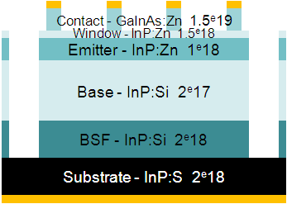
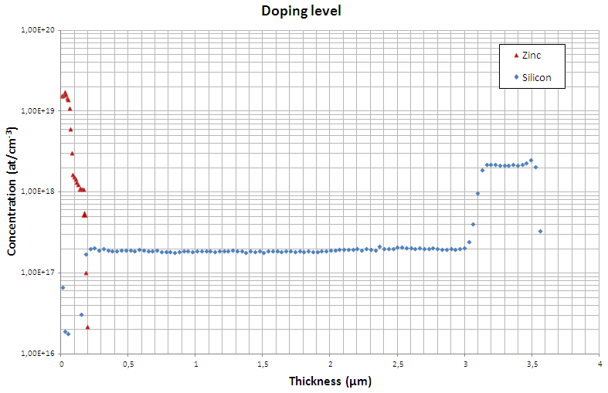
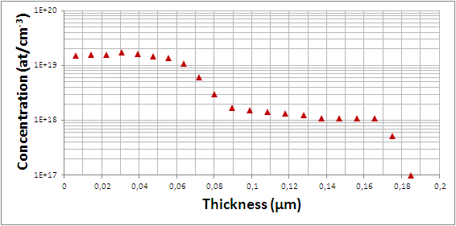
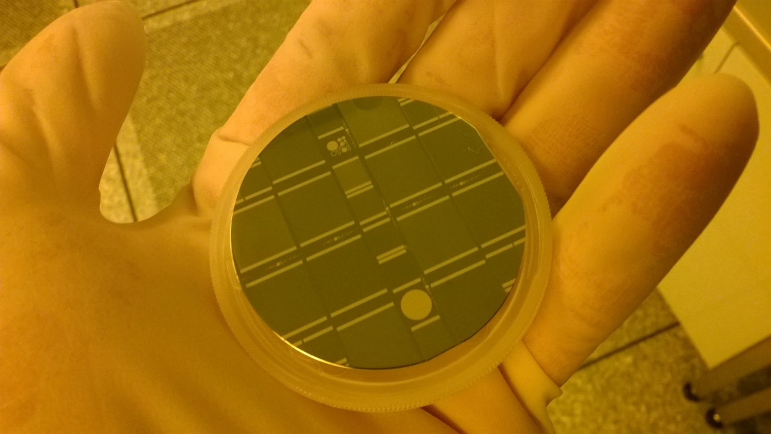
Monojunction solar cell
Theoretical study, characterization, techno and
measurements
Cell structure
First complete cell
Doping profile by SIMS measurements

Slide 7
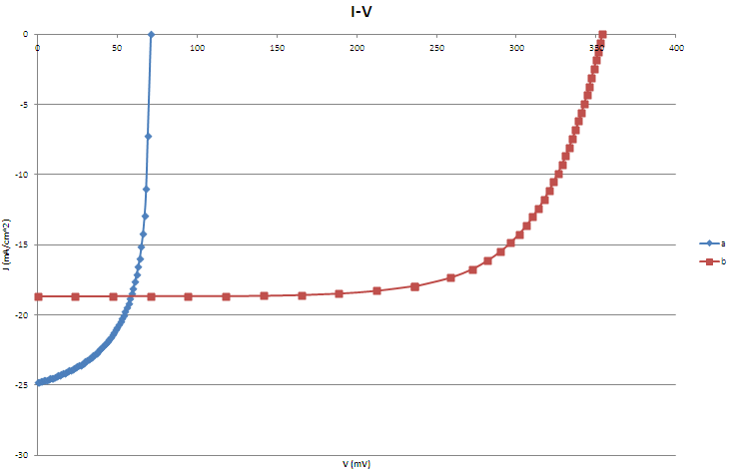
First results
a: 60 nm GaInAs →
problem with cap layer and
front contact
b: 260 nm GaInAs
+ optimized annealing
c: b + 115 nm Si₃N₄ (lateral
passivation and ARC)
 | V_{OC} (mV) | J_{SC} (mA/cm²) | FF (%) | η (%)
a | 70.94 | 24.82 | 62.0 | 1.09
b | 353.96 | 18.69 | 69.3 | 4.58
c
First I-V profiles
First results

Slide 8
Next steps
Monojunction cell:
Cell optimization: thickness + doping level
Techno optimization: mask + lateral passivation/ARC
Expected efficiency: ≈ 15%

Slide 9
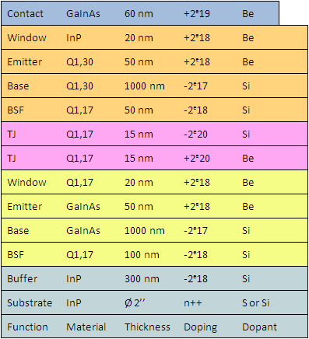
Next steps
Monojunction cell:
Cell optimization: thickness + doping level
Techno optimization: mask + lateral passivation/ARC
Expected efficiency: ≈ 15%
Multijunction cell:
Idem (by MBE)
Multijunction cell structure

Slide 10
Next steps
Monojunction cell:
Cell optimization: thickness + doping level
Techno optimization: mask + lateral passivation/ARC
Expected efficiency: ≈ 15%
Multijunction cell:
Idem (by MBE)
? Start to work on Sb templates
Multijunction cell structure

Slide 11
THANK YOU FOR
YOUR ATTENTION

